Slide 1
Basic Pose Estimation (3d)
Getting to know and understand OpenCV and Mediapipe

Slide 2
Basic Principles
Keypoint detection → Pose Estimation
Mediapipe
Fast image pose detection
2 step detector
Detection
Tracking

Slide 3
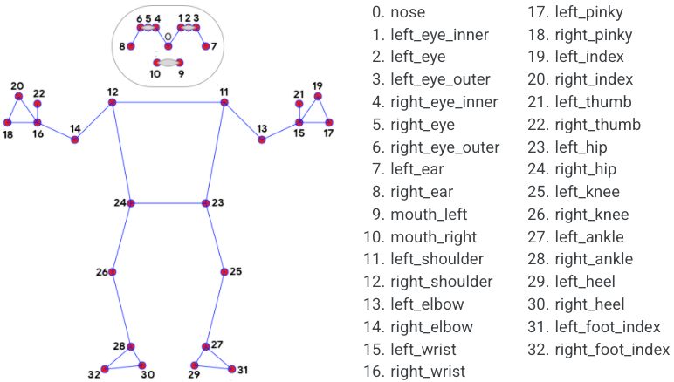
Created Function
Takes in an image
Outputs original image + image with overlay of landmarks
Outputs 3D graph of x,y,z coordinates of landmarks

Slide 4
Limitations
Sometimes the 3D rendering is off (my body tilts a lot more than it should)
Doesn't apply a motion manifold and thus cannot be as accurate
Limited to the 33 landmark points that are defined in the Mediapipe library
Cannot detect individual fingers/toes
Only a stick figure and doesn’t get the full 3d element of a person

Slide 5
Next Steps
Apply to video and webcam
Measure and create a matrix of angles to identify poses
Could be used for standard poses like in yoga/workouts
Form for sports [basketball free-throws, lacrosse throws/follow through]

